Slide 1
Name
Department, Institution
Course Code & Name
Professor
Date

Slide 2
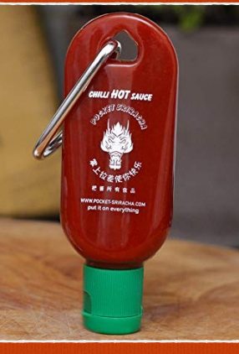
Anything is edible if enough hot sauce is applied.
Bring Your Best Self Forward.
Are You Capable of Handling It?
Each Bite has a Unique Temperature.
Favorite Family Recipes on a Daily Basis
To The Adorer.
The Fire Game.
Increase Your Exposure!
Contributes to the flavor of food.
Favorite Family Recipes on a Daily Basis.

Slide 3
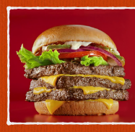
keep an eye on the fries
Goals for burgers
The only burger that's horrible is the one you didn't eat.
Burgers are a cure-all for whatever ails you.
It's burger time!
Please add more cheese.
Burgerlicious
i work out because i love burgers

Slide 4

And you've regained your vigor! It's time to make a move.
Consume the vitality.Energy.
It's made up of the things you'll need.
Life is an experience that should be shared.
MNT Energy Drink will keep you wild and natural.
Monster Energy makes you feel more energized in the morning.
We've stayed put. You wouldn't be if it weren't for energy drinks.
Drink Monster Energy to become more human.
Make a sweat for it, and you'll have more energy.
in order for me to be able to wake up and enjoy my day!

Slide 5

Consider the little things.
Gas pains are relieved.
For the sake of the automobile.
Prices are surprisingly average.
For boys who were born to be men.
It's a Volkswagen, not a vehicle.
If your gas discomfort isn't going away, try Volkswagen.
If only life could be as dependable as a Volkswagen Volkswagen.
Drivers are essential.

Slide 6
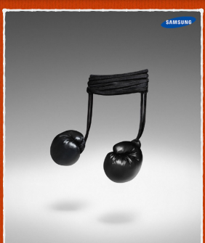
Create the future by inspiring the world.
Designed with Humans in mind.
The telephone service you need
Get your cellphones out now.
The phone presence you need; the cost-effective option you want!
Cell Phones are brought to life by us.
Allow your cellphones to bear the brunt of the load.
Cell Phones that are both fast and good for you.
When phones work, they're fantastic.

Slide 7
Anything is edible if enough hot sauce is applied.
Bring Your Best Self Forward.
Are You Capable of Handling It?
Each Bite has a Unique Temperature.
Favorite Family Recipes on a Daily Basis
To The Adorer.
The Fire Game.
Increase Your Exposure!
Contributes to the flavor of food.
Favorite Family Recipes on a Daily Basis.
keep an eye on the fries
Goals for burgers
The only burger that's horrible is the one you didn't eat.
Burgers are a cure-all for whatever ails you.
It's burger time!
Please add more cheese.
Burgerlicious
i work out because i love burgers
And you've regained your vigor! It's time to make a move.
Consume the vitality.Energy.
It's made up of the things you'll need.
Life is an experience that should be shared.
MNT Energy Drink will keep you wild and natural.
Monster Energy makes you feel more energized in the morning.
We've stayed put. You wouldn't be if it weren't for energy drinks.
Drink Monster Energy to become more human.
Make a sweat for it, and you'll have more energy.
in order for me to be able to wake up and enjoy my day!
Consider the little things.
Gas pains are relieved.
For the sake of the automobile.
Prices are surprisingly average.
For boys who were born to be men.
It's a Volkswagen, not a vehicle.
If your gas discomfort isn't going away, try Volkswagen.
If only life could be as dependable as a Volkswagen Volkswagen.
Drivers are essential

